Slide 1
Booking a service through the Therapists Template while NOT logged in
Click to start presentation

Slide 2




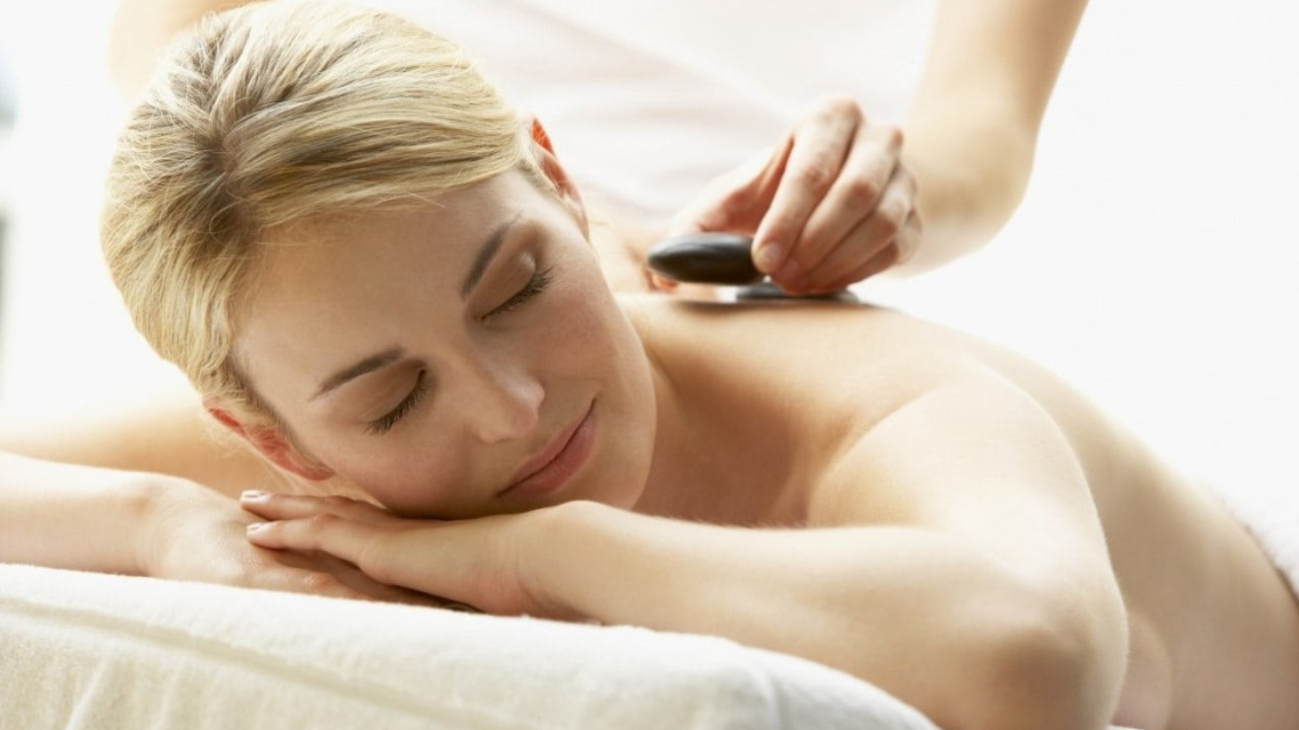
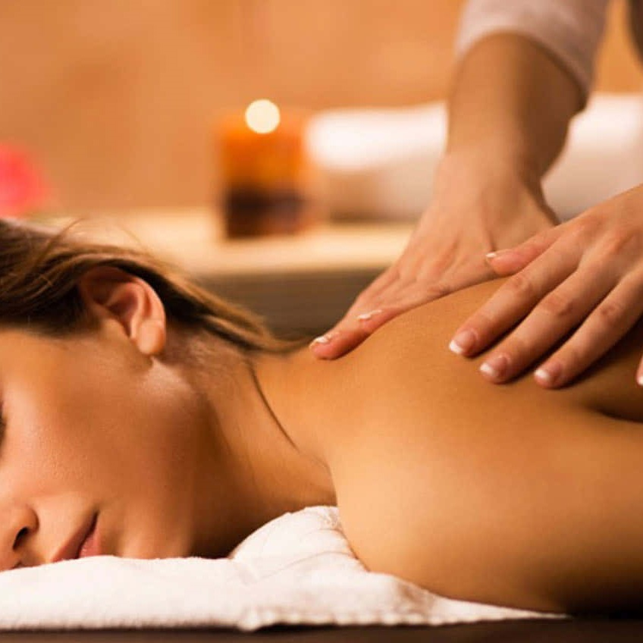
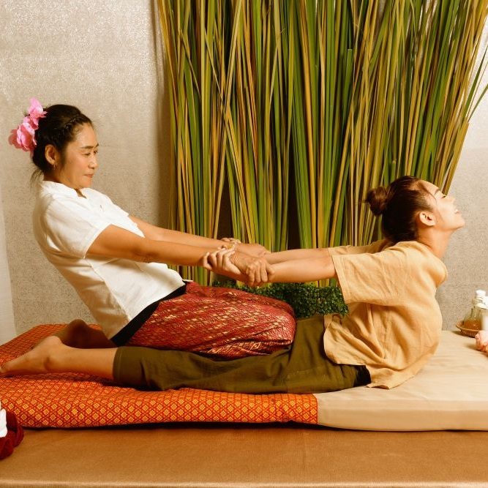
Home
Therapists
Book now
About us
Contacts
Join us
Sign in
Germany Mobile Spa
Roger Iskrenov
Verified practitioner pronouns: He/Him Field and specialty: Personal yoga trainer
Certifications & Training:
Licensed Massage Therapist (LMT)
Certified Yoga Instructor (RYT-500)
Specializations: Deep Tissue, Myofascial Release, Thai Yoga Massage
"Hi, I’m a certified massage therapist and personal yoga trainer with over 10 years of experience helping clients achieve balance, relaxation, and well-being. My holistic approach combines therapeutic massage techniques with personalized yoga sessions to bring harmony to body and mind."
Gallery
Services

Slide 3
Home
Therapists
Book now
About us
Contacts
Join us
Sign in
Germany Mobile Spa
Roger Iskrenov
Verified practitioner pronouns: He/Him Field and specialty: Personal yoga trainer
Certifications & Training:
Licensed Massage Therapist (LMT)
Certified Yoga Instructor (RYT-500)
Specializations: Deep Tissue, Myofascial Release, Thai Yoga Massage
"Hi, I’m a certified massage therapist and personal yoga trainer with over 10 years of experience helping clients achieve balance, relaxation, and well-being. My holistic approach combines therapeutic massage techniques with personalized yoga sessions to bring harmony to body and mind."
Gallery
Services

Slide 4
Home
Therapists
Book now
About us
Contacts
Join us
Sign in
Germany Mobile Spa
Roger Iskrenov
Verified practitioner pronouns: He/Him Field and specialty: Personal yoga trainer
Certifications & Training:
Licensed Massage Therapist (LMT)
Certified Yoga Instructor (RYT-500)
Specializations: Deep Tissue, Myofascial Release, Thai Yoga Massage
"Hi, I’m a certified massage therapist and personal yoga trainer with over 10 years of experience helping clients achieve balance, relaxation, and well-being. My holistic approach combines therapeutic massage techniques with personalized yoga sessions to bring harmony to body and mind."
Gallery
Services
Services
Our practitioners are available daily from 8.00am until 7.00pm. If requiring services after 7.00pm additional 200 Baht/hour will be added to each service.
Thai Massage
Experience the ancient art of Thai massage. A therapeutic practice that combines gentle stretching, acupressure, and rhythmic movements. This full-body treatment promotes flexibility, relieves tension, and restores balance, leaving you refreshed and rejuvenated.
60 minutes: 25.00 € 90 minutes: 35.00 €
Relaxing Oil Massage
Deep Tissue Massage
Slimming Massage
Jet Lag Massage
Myofascial Massage
Pregnancy Massage
Foot Massage
Foot Scrub
Body Scrub
Facial Treatment
Yoga Personal Trainer
Manicure
Book
Pedicure
Book

Slide 5
Roger Iskrenov
Verified practitioner pronouns: He/Him Field and specialty: Personal yoga trainer
Certifications & Training:
Licensed Massage Therapist (LMT)
Certified Yoga Instructor (RYT-500)
Specializations: Deep Tissue, Myofascial Release, Thai Yoga Massage
"Hi, I’m a certified massage therapist and personal yoga trainer with over 10 years of experience helping clients achieve balance, relaxation, and well-being. My holistic approach combines therapeutic massage techniques with personalized yoga sessions to bring harmony to body and mind."
Gallery
Services
Home
Therapists
Book now
About us
Contacts
Join us
Sign in
Germany Mobile Spa
Services
Our practitioners are available daily from 8.00am until 7.00pm. If requiring services after 7.00pm additional 200 Baht/hour will be added to each service.
Thai Massage
Experience the ancient art of Thai massage. A therapeutic practice that combines gentle stretching, acupressure, and rhythmic movements. This full-body treatment promotes flexibility, relieves tension, and restores balance, leaving you refreshed and rejuvenated.
60 minutes: 25.00 € 90 minutes: 35.00 € 120 minutes: 45.00 €
Relaxing Oil Massage
Deep Tissue Massage
Slimming Massage
Jet Lag Massage
Myofascial Massage
Pregnancy Massage
Foot Massage
Foot Scrub
Body Scrub
Facial Treatment
Yoga Personal Trainer
Book
Manicure
Pedicure

Slide 6
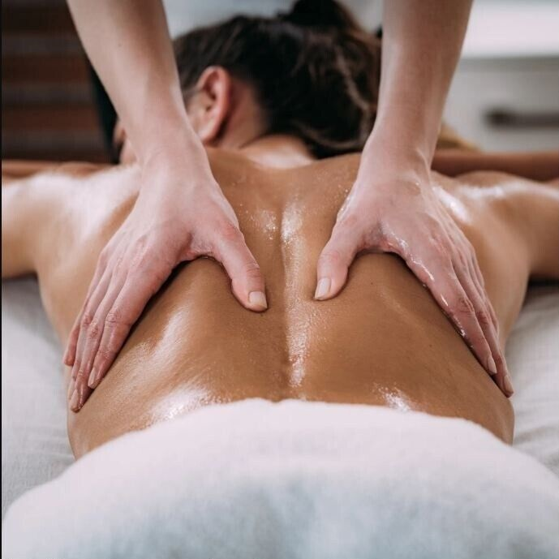
Home
Therapists
Book now
About us
Contacts
Join us
Sign in
Germany Mobile Spa
Services
Our practitioners are available daily from 8.00am until 7.00pm. If requiring services after 7.00pm additional 200 Baht/hour will be added to each service.
Thai Massage
Indulge in a Relaxing Oil Massage, designed to melt away stress and soothe your senses. Smooth, flowing strokes with aromatic oils ease muscle tension, enhance circulation, and promote deep relaxation, leaving you feeling calm, refreshed, and rejuvenated.
60 minutes: 25.00 € 90 minutes: 35.00 € 120 minutes: 45.00 €
Relaxing Oil Massage
Deep Tissue Massage
Slimming Massage
Jet Lag Massage
Myofascial Massage
Pregnancy Massage
Foot Massage
Foot Scrub
Body Scrub
Facial Treatment
Yoga Personal Trainer
Book
Manicure
Pedicure

Slide 7
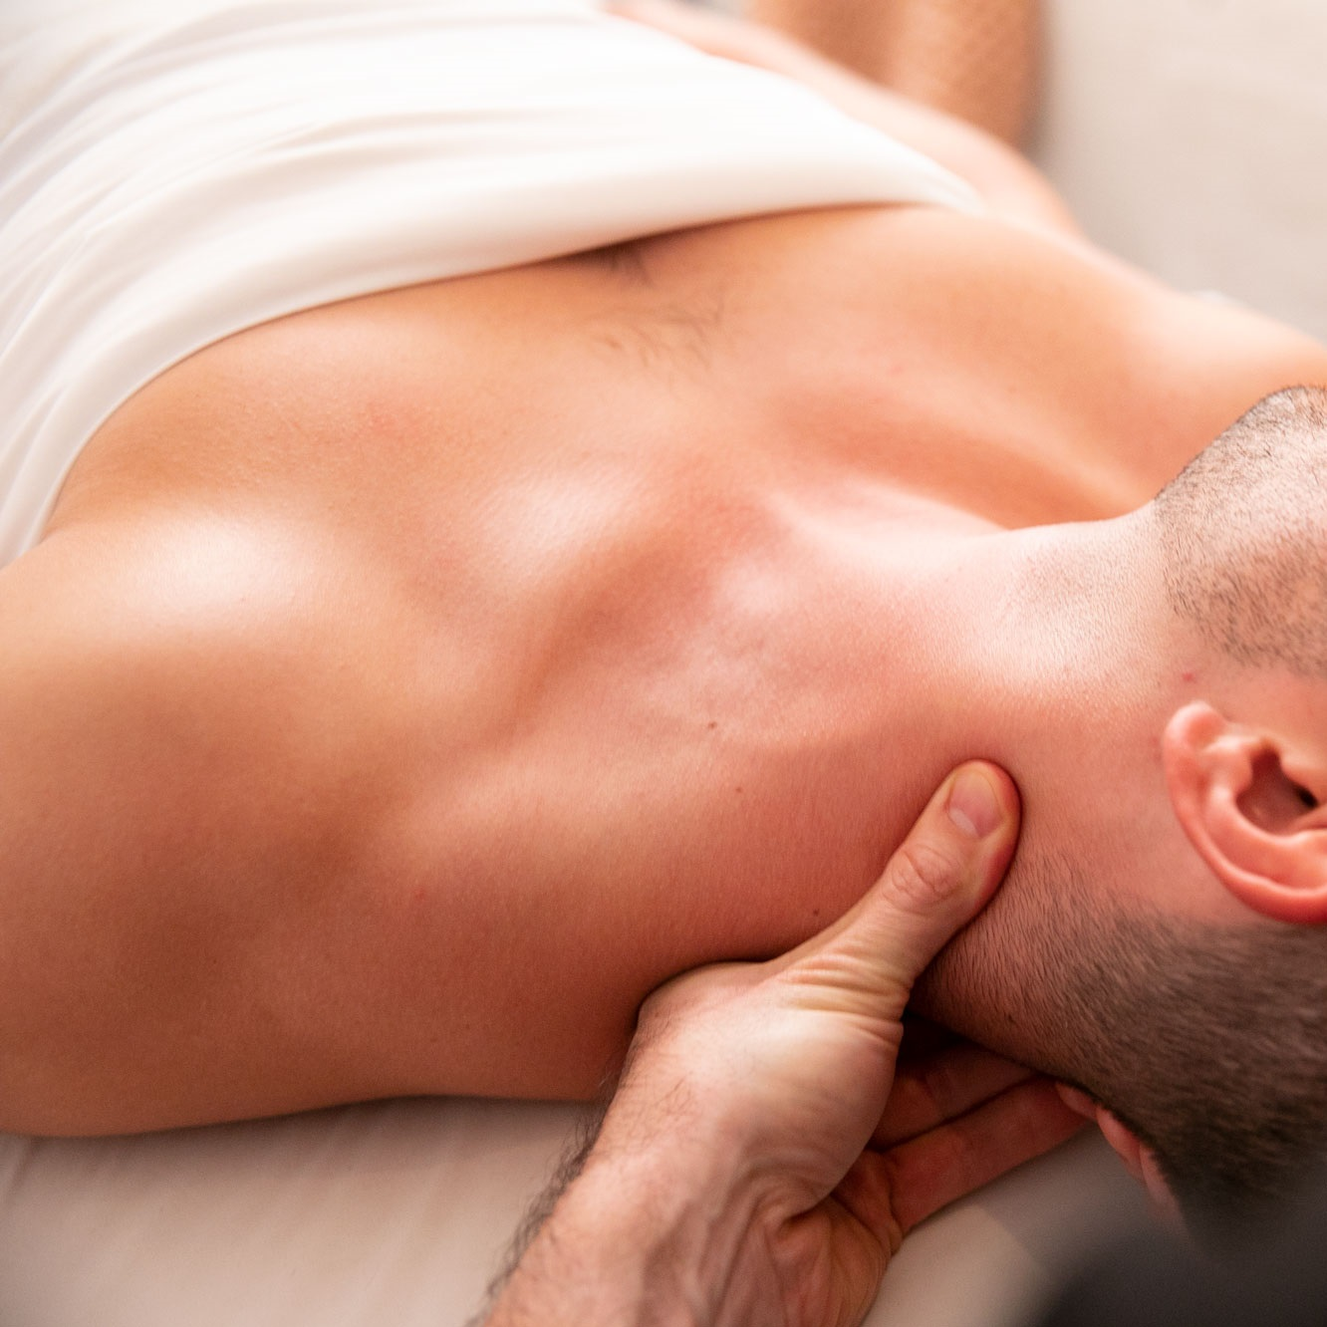
Home
Therapists
Book now
About us
Contacts
Join us
Sign in
Germany Mobile Spa
Services
Our practitioners are available daily from 8.00am until 7.00pm. If requiring services after 7.00pm additional 200 Baht/hour will be added to each service.
Thai Massage
The rejuvenating power of a Deep Tissue Massage, targeting deeper layers of muscle and connective tissue. With firm pressure and focused techniques, this treatment relieves chronic tension, eases tightness, and promotes recovery, leaving you feeling restored and revitalized.
60 minutes: 35.00 € 90 minutes: 50.00 € 120 minutes: 65.00 €
Relaxing Oil Massage
Deep Tissue Massage
Slimming Massage
Jet Lag Massage
Myofascial Massage
Pregnancy Massage
Foot Massage
Foot Scrub
Body Scrub
Facial Treatment
Yoga Personal Trainer
Book
Manicure
Pedicure

Slide 8
Home
Therapists
Book now
About us
Contacts
Join us
Sign in
Germany Mobile Spa
Services
Our practitioners are available daily from 8.00am until 7.00pm. If requiring services after 7.00pm additional 200 Baht/hour will be added to each service.
Thai Massage
The rejuvenating power of a Deep Tissue Massage, targeting deeper layers of muscle and connective tissue. With firm pressure and focused techniques, this treatment relieves chronic tension, eases tightness, and promotes recovery, leaving you feeling restored and revitalized.
60 minutes: 35.00 € 90 minutes: 50.00 € 120 minutes: 65.00 €
Relaxing Oil Massage
Deep Tissue Massage
Slimming Massage
Jet Lag Massage
Myofascial Massage
Pregnancy Massage
Foot Massage
Foot Scrub
Body Scrub
Facial Treatment
Yoga Personal Trainer
Book
Manicure
Pedicure

Slide 9
Home
Therapists
Book now
About us
Contacts
Join us
Sign in
Germany Mobile Spa
Services
Our practitioners are available daily from 8.00am until 7.00pm. If requiring services after 7.00pm additional 200 Baht/hour will be added to each service.
Thai Massage
The rejuvenating power of a Deep Tissue Massage, targeting deeper layers of muscle and connective tissue. With firm pressure and focused techniques, this treatment relieves chronic tension, eases tightness, and promotes recovery, leaving you feeling restored and revitalized.
60 minutes: 35.00 € 90 minutes: 50.00 € 120 minutes: 65.00 €
Relaxing Oil Massage
Deep Tissue Massage
Slimming Massage
Jet Lag Massage
Myofascial Massage
Pregnancy Massage
Foot Massage
Foot Scrub
Body Scrub
Facial Treatment
Yoga Personal Trainer
Book
Manicure
Pedicure

Slide 10
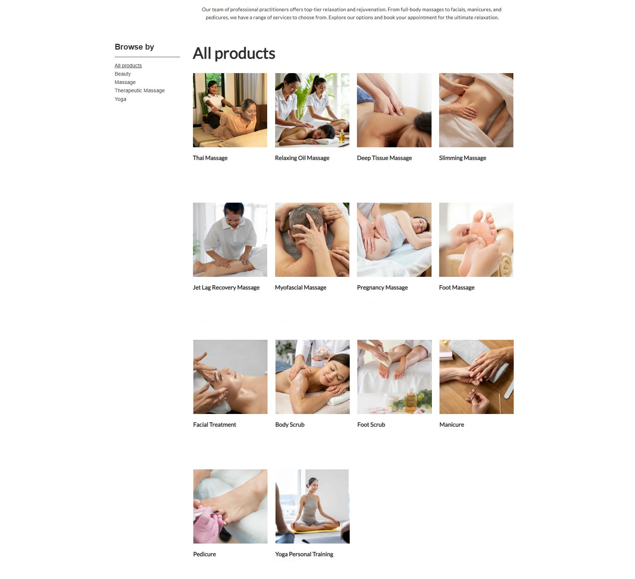
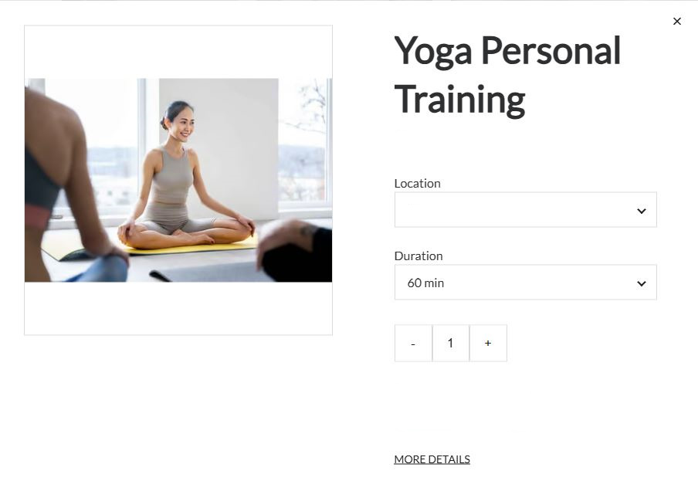
From 25€ From 25€ From 35€ From 50€
Book
Book
Book
Book
Home
Therapists
Book now
About us
Contacts
Join us
Sign in
Continue
Germany Mobile Spa
From 45€ From 35€ From 25€ From 25€
Book
Book
Book
Book
Deep Tissue Massage
50.00€
From 50€ From 35€ From 30€ From 25€
Choose later
Book
Book
Book
Book
Attendants
- 4 +
Preferred Therapist
Single
Male
Couple
Next
Female
Groups
No preference
From 25€ From 50€
Book
Book

Slide 11
From 25€ From 25€ From 35€ From 50€
Book
Book
Book
Book
Home
Therapists
Book now
About us
Contacts
Join us
Sign in
Continue
Germany Mobile Spa
From 45€ From 35€ From 25€ From 25€
Book
Book
Book
Book
Deep Tissue Massage
50.00€
From 50€ From 35€ From 30€ From 25€
Choose later
Book
Book
Book
Book
Attendants
- 4 +
Preferred Therapist
Single
Male
Couple
Next
Female
Groups
No preference
From 25€ From 50€
Book
Book

Slide 12
From 25€ From 25€ From 35€ From 50€
Book
Book
Book
Book
Home
Therapists
Book now
About us
Contacts
Join us
Sign in
Continue
Germany Mobile Spa
From 45€ From 35€ From 25€ From 25€
Book
Book
Book
Book
Deep Tissue Massage
50.00€
From 50€ From 35€ From 30€ From 25€
Choose later
Book
Book
Book
Book
Attendants
- 4 +
Preferred Therapist
Single
Male
Couple
Next
Female
Groups
No preference
From 25€ From 50€
Book
Book

Slide 13
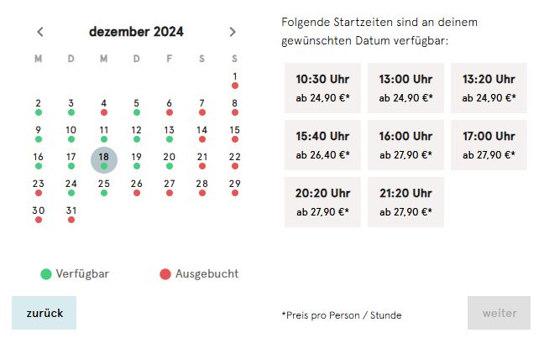
From 25€ From 25€ From 35€ From 50€
Book
Book
Book
Book
Continue
Home
Therapists
Book now
About us
Contacts
Join us
Sign in
Germany Mobile Spa
From 45€ From 35€ From 25€ From 25€
Book
Book
Book
Book
December
8:00 am
2:00 pm
8:00 pm
From 50€ From 35€ From 30€ From 25€
10:00 am
4:00 pm
10:00 pm
Book
Book
Book
Book
12:00 am
6:00 pm
Available
Booked out
Back
Pay
From 25€ From 50€
Book
Book

Slide 14
From 25€ From 25€ From 35€ From 50€
Book
Book
Book
Book
Continue
Home
Therapists
Book now
About us
Contacts
Join us
Sign in
Germany Mobile Spa
From 45€ From 35€ From 25€ From 25€
Book
Book
Book
Book
December
8:00 am
2:00 pm
8:00 pm
From 50€ From 35€ From 30€ From 25€
10:00 am
4:00 pm
10:00 pm
Book
Book
Book
Book
12:00 am
6:00 pm
Available
Booked out
Back
Pay
From 25€ From 50€
Book
Book

Slide 15
From 25€ From 25€ From 35€ From 50€
Book
Book
Book
Book
Continue
Home
Therapists
Book now
About us
Contacts
Join us
Sign in
Germany Mobile Spa
From 45€ From 35€ From 25€ From 25€
Book
Book
Book
Book
December
8:00 am
2:00 pm
8:00 pm
From 50€ From 35€ From 30€ From 25€
10:00 am
4:00 pm
10:00 pm
Book
Book
Book
Book
12:00 am
6:00 pm
Available
Booked out
Back
Pay
From 25€ From 50€
Book
Book

Slide 16
From 25€ From 25€ From 35€ From 50€
Book
Book
Book
Book
Home
Therapists
Book now
About us
Contacts
Join us
Sign in
Germany Mobile Spa
From 45€ From 35€ From 25€ From 25€
Book
Book
Book
Book
From 50€ From 35€ From 30€ From 25€
Book
Book
Book
Book
From 25€ From 50€
Book
Book

Slide 17


Home
Therapists
Book now
About us
Contacts
Join us
Sign in
Germany Mobile Spa
Join us
Sign in
Services
Our practitioners are available daily from 8.00am until 7.00pm. If requiring services after 7.00pm additional 200 Baht/hour will be added to each service.
Thai Massage
Login with existing account
Register a new account
The rejuvenating power of a Deep Tissue Massage, targeting deeper layers of muscle and connective tissue. With firm pressure and focused techniques, this treatment relieves chronic tension, eases tightness, and promotes recovery, leaving you feeling restored and revitalized.
60 minutes: 35.00 € 90 minutes: 50.00 € 120 minutes: 65.00 €
Relaxing Oil Massage
Deep Tissue Massage
Slimming Massage
Jet Lag Massage
Myofascial Massage
Sign up with Google
Sign in with Google
Pregnancy Massage
Foot Massage
Foot Scrub
Sign up with Facebook
Sign in with Facebook
Body Scrub
Facial Treatment
Yoga Personal Trainer
Book
Manicure
Pedicure

Slide 18
We are now redirected to the login/register page
After whichever process is done we are redirected back to this page to pay You can see the login/register processeses in presentations #2 and #3 (Press to continue)

Slide 19
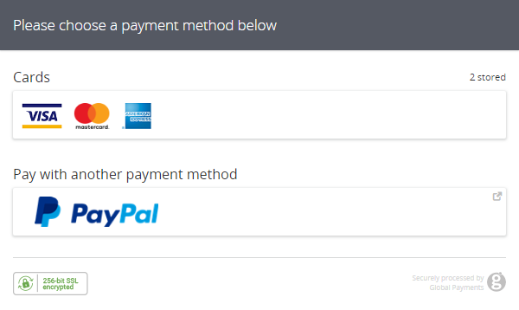
From 25€ From 25€ From 35€ From 50€
Book
Book
Book
Book
Home
Therapists
Book now
About us
Contacts
Profile
Sign out
Germany Mobile Spa
From 45€ From 35€ From 25€ From 25€
Book
Book
Book
Book
From 50€ From 35€ From 30€ From 25€
Book
Book
Book
Book
From 25€ From 50€
Book
Book

Slide 20
Booking a service through the Booking Template
While NOT logged in
Click to continue presentation

Slide 21

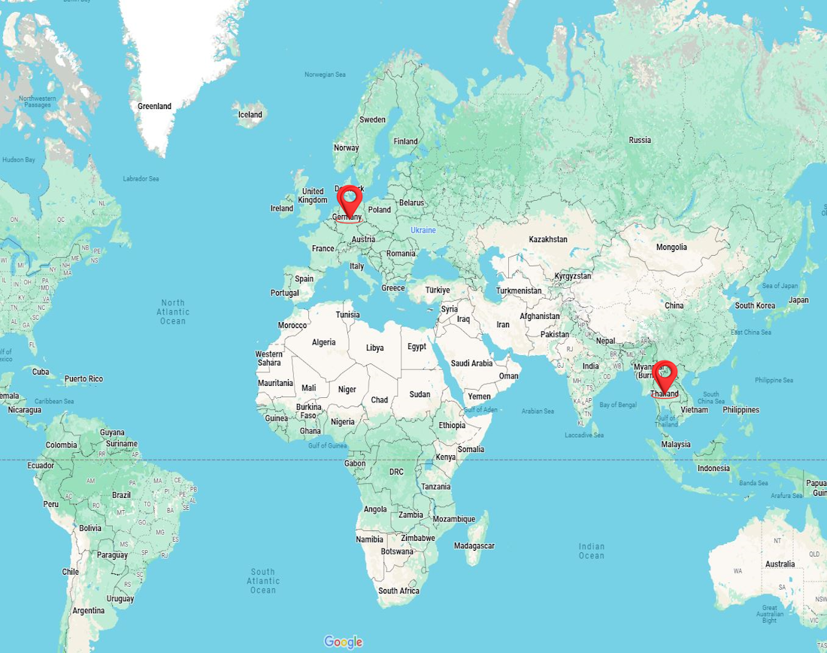
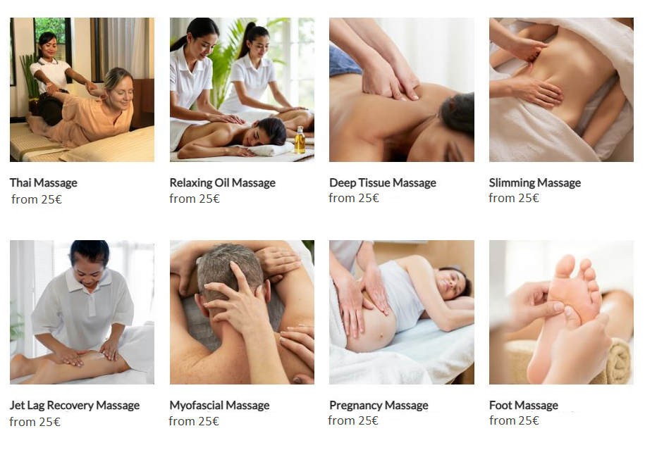
Relax. Rejuvenate. Renew.
Discover the healing power of touch. Our expert massage therapies not only melt away stress but also improve circulation, relieve muscle tension, and promote overall well-being. Invest in your health —because you deserve it.
Find your closest therapist
Home
Therapists
Book now
About us
Contacts
Join us
Sign in
Germany Mobile Spa
Enter your address
Choose a country
Choose a city
Services

Slide 22
Relax. Rejuvenate. Renew.
Discover the healing power of touch. Our expert massage therapies not only melt away stress but also improve circulation, relieve muscle tension, and promote overall well-being. Invest in your health —because you deserve it.
Find your closest therapist
Home
Therapists
Book now
About us
Contacts
Join us
Sign in
Germany Mobile Spa
Enter your address
Choose a country
Choose a city
Services

Slide 23


Relax. Rejuvenate. Renew.
Discover the healing power of touch. Our expert massage therapies not only melt away stress but also improve circulation, relieve muscle tension, and promote overall well-being. Invest in your health —because you deserve it.
Find your closest therapist
Home
Therapists
Book now
About us
Contacts
Join us
Sign in
Germany Mobile Spa
Enter your address
Choose a country
Germany
Choose a city
Choose a city
Services
Thailand
Services

Slide 24
Relax. Rejuvenate. Renew.
Discover the healing power of touch. Our expert massage therapies not only melt away stress but also improve circulation, relieve muscle tension, and promote overall well-being. Invest in your health —because you deserve it.
Find your closest therapist
Home
Therapists
Book now
About us
Contacts
Join us
Sign in
Germany Mobile Spa
Enter your address
Choose a country
Germany
Choose a city
Choose a city
Services
Thailand
Services

Slide 25
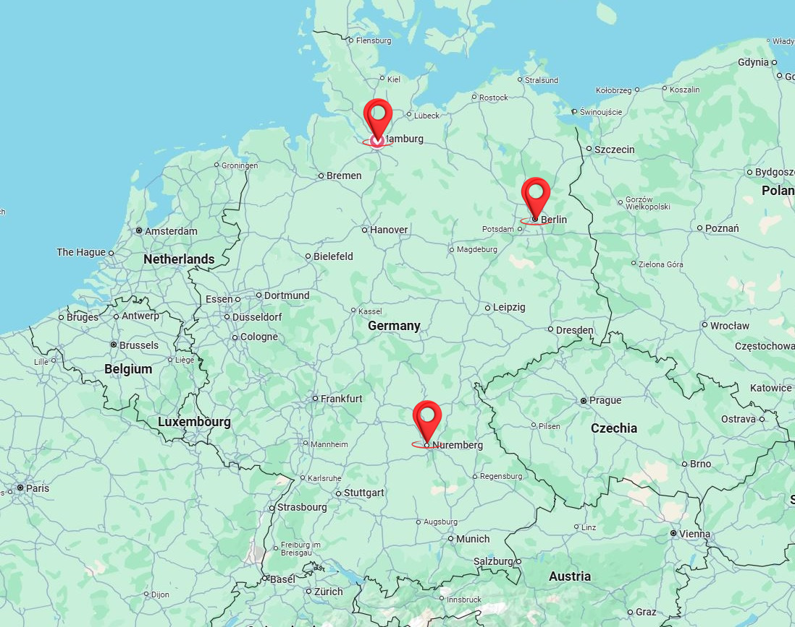
Relax. Rejuvenate. Renew.
Discover the healing power of touch. Our expert massage therapies not only melt away stress but also improve circulation, relieve muscle tension, and promote overall well-being. Invest in your health —because you deserve it.
Find your closest therapist
Home
Therapists
Book now
About us
Contacts
Join us
Sign in
Germany Mobile Spa
Enter your address
Germany
Choose a city
Services

Slide 26
Home
Therapists
Book now
About us
Contacts
Join us
Sign in
Germany Mobile Spa
Enter your address
Germany
Choose a city
Services

Slide 27
Home
Therapists
Book now
About us
Contacts
Join us
Sign in
Germany Mobile Spa
Enter your address
Germany
Choose a city
Berlin
Services
Hamburg
Stuttgard

Slide 28
Home
Therapists
Book now
About us
Contacts
Join us
Sign in
Germany Mobile Spa
Enter your address
Germany
Choose a city
Berlin
Services
Hamburg
Stuttgard

Slide 29
Home
Therapists
Book now
About us
Contacts
Join us
Sign in
Germany Mobile Spa
Enter your address
Germany
Berlin
Services

Slide 30
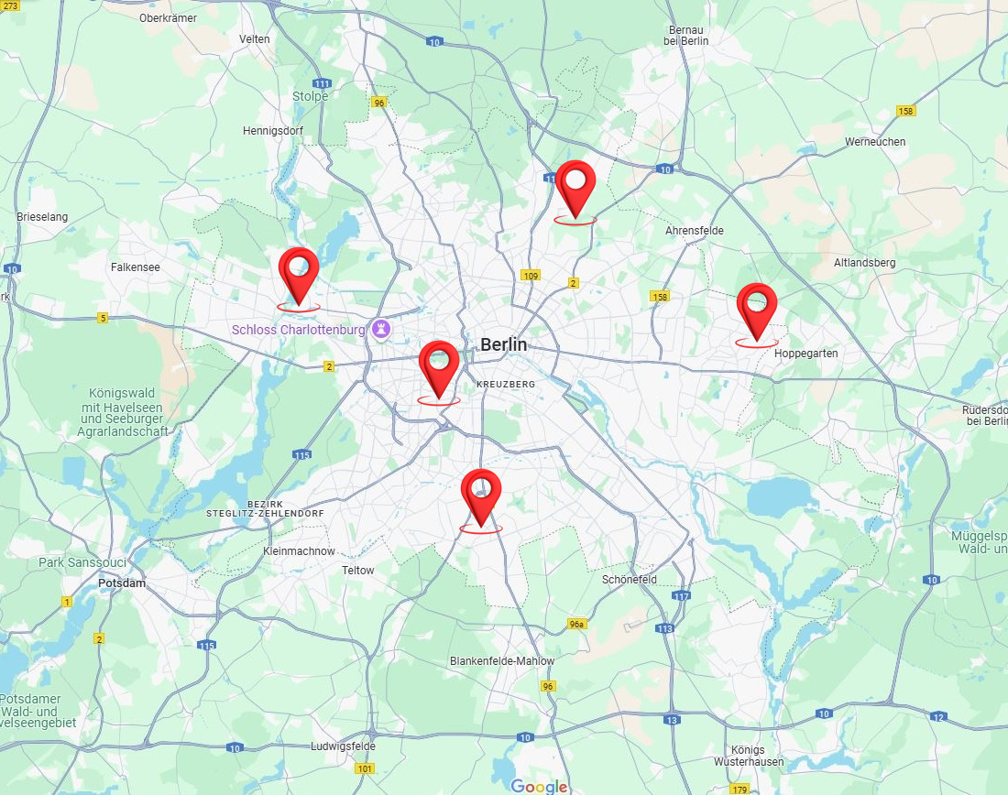
Home
Therapists
Book now
About us
Contacts
Join us
Sign in
Germany Mobile Spa
Enter your address
Germany
Berlin
Services

Slide 31
Home
Therapists
Book now
About us
Contacts
Join us
Sign in
Germany Mobile Spa
Enter your address
Germany
Berlin
Services

Slide 32
Home
Therapists
Book now
About us
Contacts
Join us
Sign in
Germany Mobile Spa
Enter your address
Germany
Berlin
Services

Slide 33
Home
Therapists
Book now
About us
Contacts
Join us
Sign in
Germany Mobile Spa
Enter your address
Germany
Berlin
Services

Slide 34
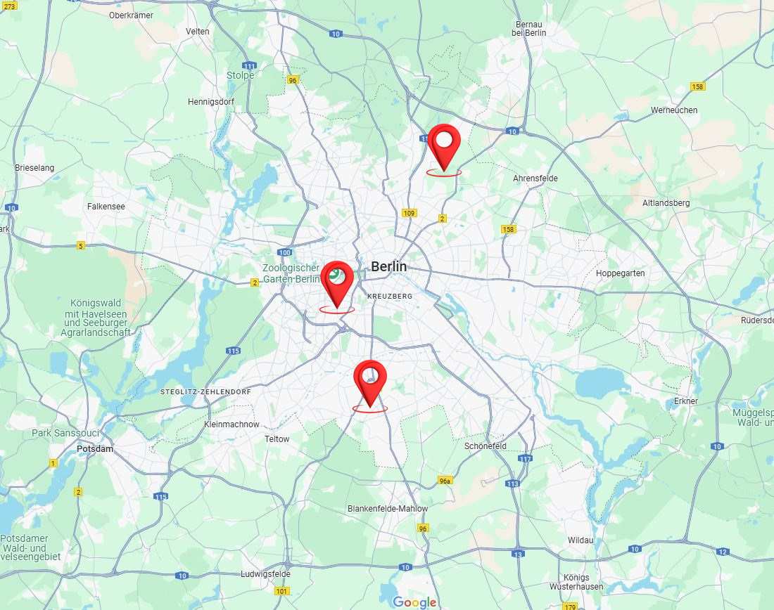
Home
Therapists
Book now
About us
Contacts
Join us
Sign in
Germany Mobile Spa
Enter your address
Germany
Berlin
Services
Discover the Benefits of Massage Therapy:
Relieves stress and anxiety
Eases muscle tension and pain
Improves circulation and flexibility
Boosts immune function and mental clarity
Why Choose Us? At [Your Business Name], we combine skill, care, and a serene environment to provide you with the ultimate relaxation experience. Our certified therapists customize each session to your needs, helping you unwind, rejuvenate, and restore balance.
Rechtliches
Impressum AGB Widerruf Datenschutz Versand
float HafenCity
Am Kaiserkai 42 20457 Hamburg Tel: 040 / 70 38 37 30 hafencity@float-hamburg.com
tägl. 10:00 – 22:00 Uhr
float Neustadt
Alter Steinweg 1 20459 Hamburg Tel: 040 / 36 93 54 64 neustadt@float-hamburg.com
tägl. 10:00 – 22:00 Uhr
float Rotherbaum
Mittelweg 160 20148 Hamburg Tel: 040 / 21 00 69 89 rotherbaum@float-hamburg.com
tägl. 10:00 – 22:00 Uhr
© 2024 [Your Business Name]. All rights reserved.
Follow us: [Social Media Icons]

Slide 35
Home
Therapists
Book now
About us
Contacts
Join us
Sign in
Germany Mobile Spa
From 25€ From 25€ From 35€ From 50€
Book
Book
Book
Book
From 45€ From 35€ From 25€ From 25€
Book
Book
Book
Book

Slide 36
Home
Therapists
Book now
About us
Contacts
Join us
Sign in
Germany Mobile Spa
From 25€ From 25€ From 35€ From 50€
Book
Book
Book
Book
From 45€ From 35€ From 25€ From 25€
Book
Book
Book
Book

Slide 37
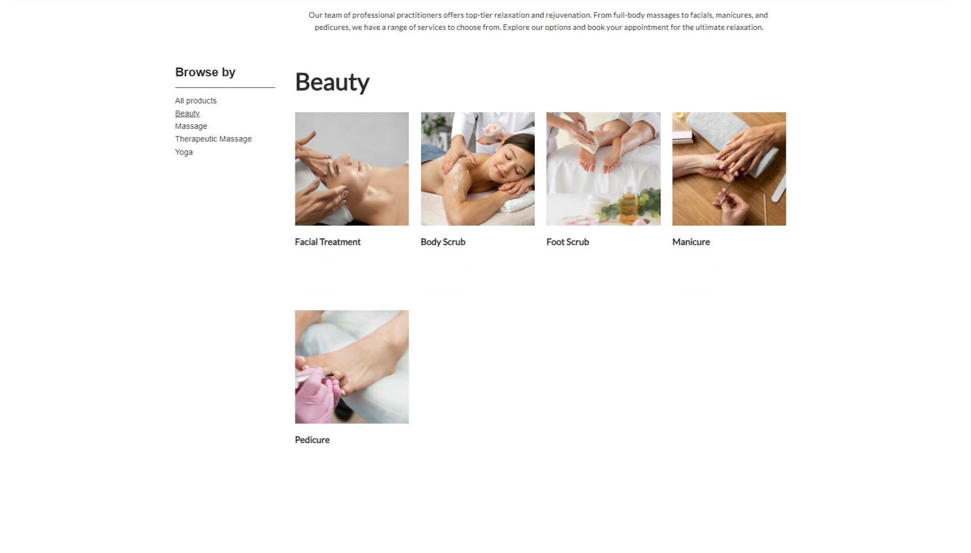
Home
Therapists
Book now
About us
Contacts
Join us
Sign in
Germany Mobile Spa
From 50€ From 35€ From 30€ From 25€
Book
Book
Book
Book
From 25€
Book

Slide 38
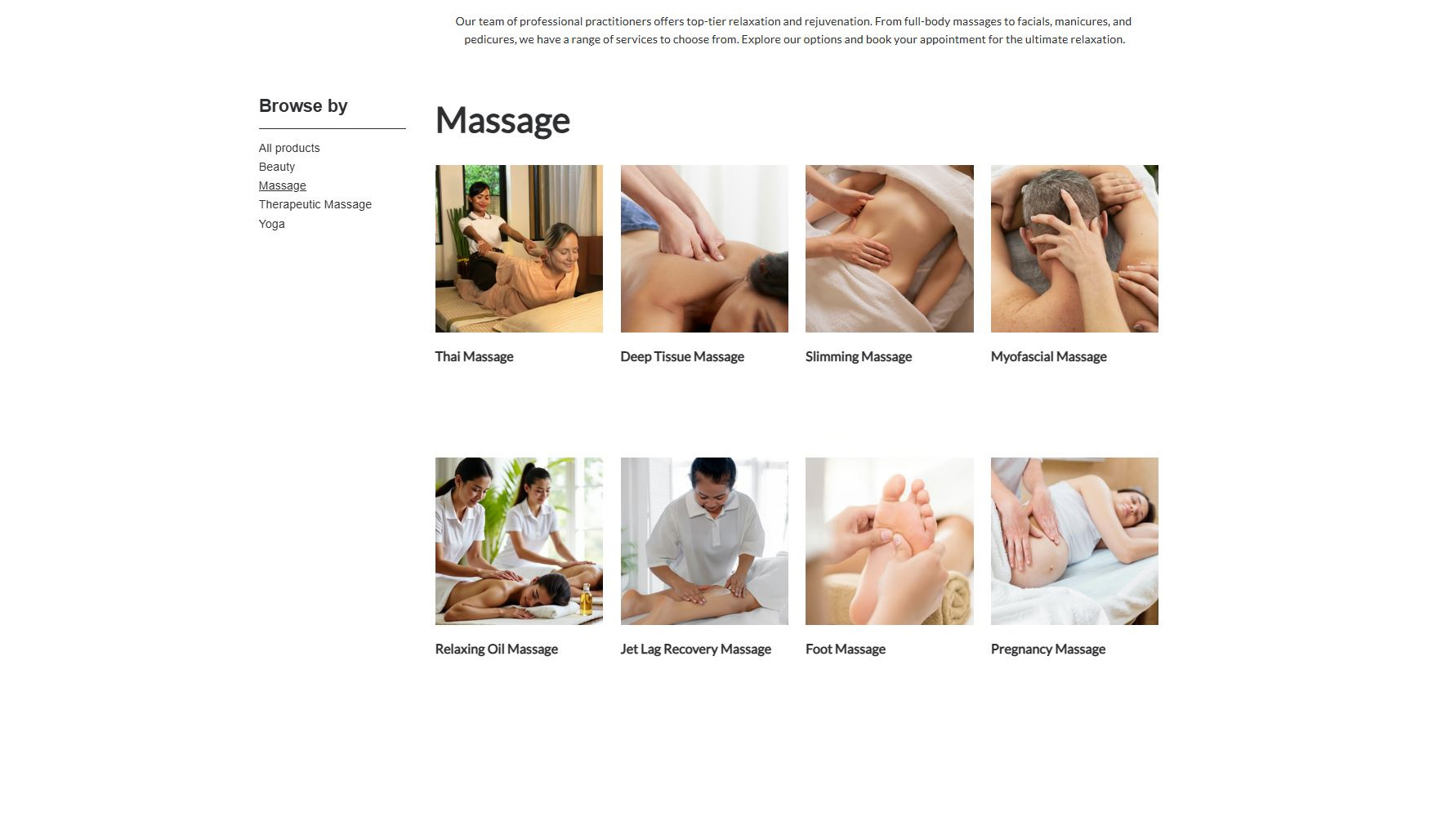
Home
Therapists
Book now
About us
Contacts
Join us
Sign in
Germany Mobile Spa
From 25€ From 35€ From 50€ From 35€
Book
Book
Book
Book
From 25€ From 45€ From 25€ From 25€
Book
Book
Book
Book

Slide 39
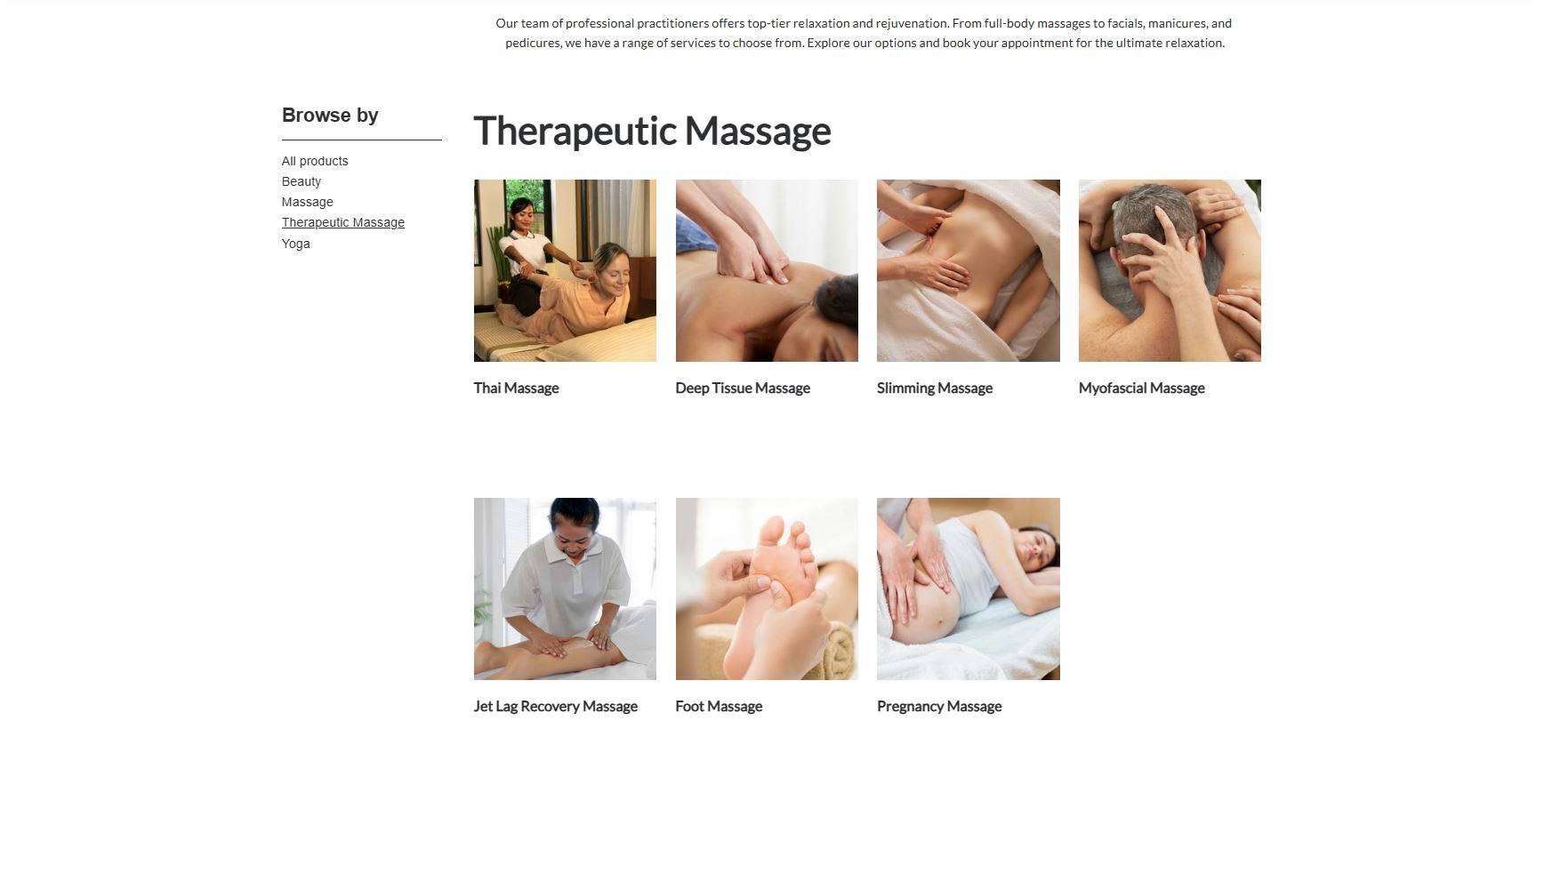
Home
Therapists
Book now
About us
Contacts
Join us
Sign in
Germany Mobile Spa
From 25€ From 35€ From 50€ From 35€
Book
Book
Book
Book
From 45€ From 25€ From 25€
Book
Book
Book

Slide 40
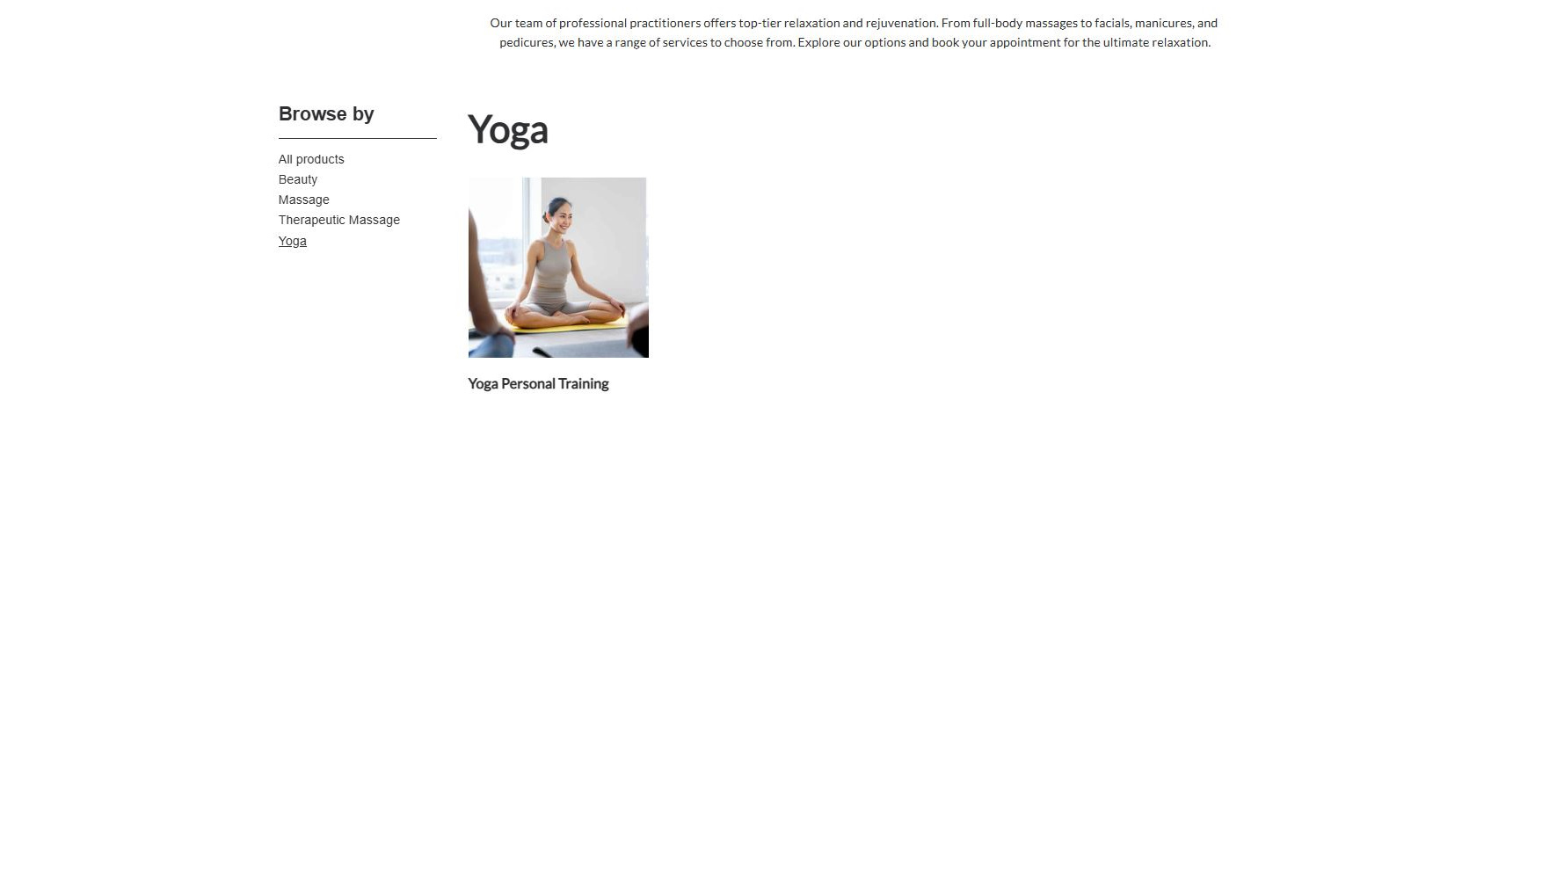
Home
Therapists
Book now
About us
Contacts
Join us
Sign in
Germany Mobile Spa
From 50€
Book

Slide 41
Home
Therapists
Book now
About us
Contacts
Join us
Sign in
Germany Mobile Spa
From 25€ From 25€ From 35€ From 50€
Book
Book
Book
Book
From 45€ From 35€ From 25€ From 25€
Book
Book
Book
Book
From 50€ From 35€ From 30€ From 25€
Book
Book
Book
Book
From 25€ From 50€
Book
Book

Slide 42
From 25€ From 25€ From 35€ From 50€
Book
Book
Book
Book
Home
Therapists
Book now
About us
Contacts
Join us
Sign in
Germany Mobile Spa
From 45€ From 35€ From 25€ From 25€
Book
Book
Book
Book
From 50€ From 35€ From 30€ From 25€
Book
Book
Book
Book
From 25€ From 50€
Book
Book

Slide 43
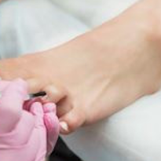
From 25€ From 25€ From 35€ From 50€
Book
Book
Book
Book
Home
Therapists
Book now
About us
Contacts
Join us
Sign in
Germany Mobile Spa
From 45€ From 35€ From 25€ From 25€
Book
Book
Book
Book
From 50€ From 35€ From 30€ From 25€
Book
Book
Book
Book
From 25€ From 50€
Book
Book

Slide 44
From 25€ From 25€ From 35€ From 50€
Book
Book
Book
Book
Home
Therapists
Book now
About us
Contacts
Join us
Sign in
Germany Mobile Spa
From 45€ From 35€ From 25€ From 25€
Book
Book
Book
Book
From 50€ From 35€ From 30€ From 25€
Book
Book
Book
Book
From 25€ From 50€
Book
Book

Slide 45

From 25€ From 25€ From 35€ From 50€
Book
Book
Book
Book
Home
Therapists
Book now
About us
Contacts
Join us
Sign in
Germany Mobile Spa
From 45€ From 35€ From 25€ From 25€
Book
Book
Book
Book
From 50€ From 35€ From 30€ From 25€
Book
Book
Book
Book
From 25€ From 50€
Book
Book

Slide 46
From 25€ From 25€ From 35€ From 50€
Book
Book
Book
Book
Home
Therapists
Book now
About us
Contacts
Join us
Sign in
Germany Mobile Spa
From 45€ From 35€ From 25€ From 25€
Book
Book
Book
Book
From 50€ From 35€ From 30€ From 25€
Book
Book
Book
Book
From 25€ From 50€
Book
Book

Slide 47
From 25€ From 25€ From 35€ From 50€
Book
Book
Book
Book
Home
Therapists
Book now
About us
Contacts
Join us
Sign in
Germany Mobile Spa
From 45€ From 35€ From 25€ From 25€
Book
Book
Book
Book
From 50€ From 35€ From 30€ From 25€
Book
Book
Book
Book
From 25€ From 50€
Book
Book

Slide 48
From 25€ From 25€ From 35€ From 50€
Book
Book
Book
Book
Home
Therapists
Book now
About us
Contacts
Join us
Sign in
Continue
Germany Mobile Spa
From 45€ From 35€ From 25€ From 25€
Book
Book
Book
Book
50.00€
From 50€ From 35€ From 30€ From 25€
Choose later
Book
Book
Book
Book
Attendants
- 4 +
Preferred Therapist
Single
Male
Couple
Next
Female
Groups
No preference
From 25€ From 50€
Book
Book

Slide 49
From 25€ From 25€ From 35€ From 50€
Book
Book
Book
Book
Home
Therapists
Book now
About us
Contacts
Join us
Sign in
Continue
Germany Mobile Spa
From 45€ From 35€ From 25€ From 25€
Book
Book
Book
Book
50.00€
From 50€ From 35€ From 30€ From 25€
Choose later
Book
Book
Book
Book
Attendants
- 4 +
Preferred Therapist
Single
Male
Couple
Next
Female
Groups
No preference
From 25€ From 50€
Book
Book

Slide 50
From 25€ From 25€ From 35€ From 50€
Book
Book
Book
Book
Home
Therapists
Book now
About us
Contacts
Join us
Sign in
Continue
Germany Mobile Spa
From 45€ From 35€ From 25€ From 25€
Book
Book
Book
Book
50.00€
From 50€ From 35€ From 30€ From 25€
Choose later
Book
Book
Book
Book
Attendants
- 4 +
Preferred Therapist
Single
Male
Couple
Next
Female
Groups
No preference
From 25€ From 50€
Book
Book

Slide 51
From 25€ From 25€ From 35€ From 50€
Book
Book
Book
Book
Continue
Home
Therapists
Book now
About us
Contacts
Join us
Sign in
Germany Mobile Spa
From 45€ From 35€ From 25€ From 25€
Book
Book
Book
Book
December
8:00 am
2:00 pm
8:00 pm
From 50€ From 35€ From 30€ From 25€
10:00 am
4:00 pm
10:00 pm
Book
Book
Book
Book
12:00 am
6:00 pm
Available
Booked out
Back
Pay
From 25€ From 50€
Book
Book

Slide 52
From 25€ From 25€ From 35€ From 50€
Book
Book
Book
Book
Continue
Home
Therapists
Book now
About us
Contacts
Join us
Sign in
Germany Mobile Spa
From 45€ From 35€ From 25€ From 25€
Book
Book
Book
Book
December
8:00 am
2:00 pm
8:00 pm
From 50€ From 35€ From 30€ From 25€
10:00 am
4:00 pm
10:00 pm
Book
Book
Book
Book
12:00 am
6:00 pm
Available
Booked out
Back
Pay
From 25€ From 50€
Book
Book

Slide 53
From 25€ From 25€ From 35€ From 50€
Book
Book
Book
Book
Continue
Home
Therapists
Book now
About us
Contacts
Join us
Sign in
Germany Mobile Spa
From 45€ From 35€ From 25€ From 25€
Book
Book
Book
Book
December
8:00 am
2:00 pm
8:00 pm
From 50€ From 35€ From 30€ From 25€
10:00 am
4:00 pm
10:00 pm
Book
Book
Book
Book
12:00 am
6:00 pm
Available
Booked out
Back
Pay
From 25€ From 50€
Book
Book

Slide 54
From 25€ From 25€ From 35€ From 50€
Book
Book
Book
Book
Home
Therapists
Book now
About us
Contacts
Join us
Sign in
Germany Mobile Spa
From 45€ From 35€ From 25€ From 25€
Book
Book
Book
Book
From 50€ From 35€ From 30€ From 25€
Book
Book
Book
Book
From 25€ From 50€
Book
Book

Slide 55
We are now redirected to the login/register page
After whichever process is done we are redirected back to this page to pay You can see the login/register processeses in presentations #2 and #3 (Press to continue)

Slide 56
Home
Therapists
Book now
About us
Contacts
Join us
Sign in
Germany Mobile Spa
Join us
Sign in
Services
Our practitioners are available daily from 8.00am until 7.00pm. If requiring services after 7.00pm additional 200 Baht/hour will be added to each service.
Thai Massage
Login with existing account
Register a new account
The rejuvenating power of a Deep Tissue Massage, targeting deeper layers of muscle and connective tissue. With firm pressure and focused techniques, this treatment relieves chronic tension, eases tightness, and promotes recovery, leaving you feeling restored and revitalized.
60 minutes: 35.00 € 90 minutes: 50.00 € 120 minutes: 65.00 €
Relaxing Oil Massage
Deep Tissue Massage
Slimming Massage
Jet Lag Massage
Myofascial Massage
Sign up with Google
Sign in with Google
Pregnancy Massage
Foot Massage
Foot Scrub
Sign up with Facebook
Sign in with Facebook
Body Scrub
Facial Treatment
Yoga Personal Trainer
Book
Manicure
Pedicure

Slide 57
From 25€ From 25€ From 35€ From 50€
Book
Book
Book
Book
Home
Therapists
Book now
About us
Contacts
Profile
Sign out
Germany Mobile Spa
From 45€ From 35€ From 25€ From 25€
Book
Book
Book
Book
From 50€ From 35€ From 30€ From 25€
Book
Book
Book
Book
From 25€ From 50€
Book
Book

Slide 58
The end
Click to exit

